Slide 1
Welcome to Reception
Sundridge and Brasted Primary School

Slide 2
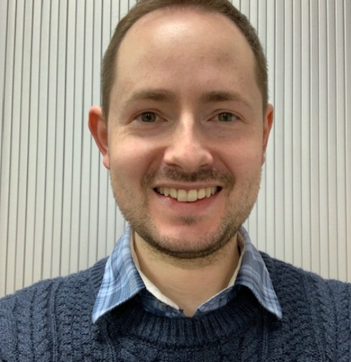
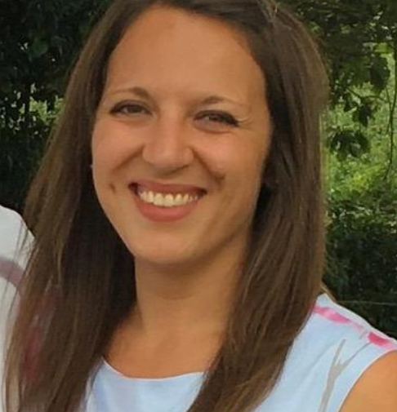
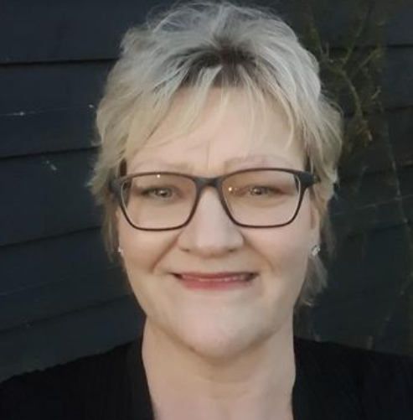
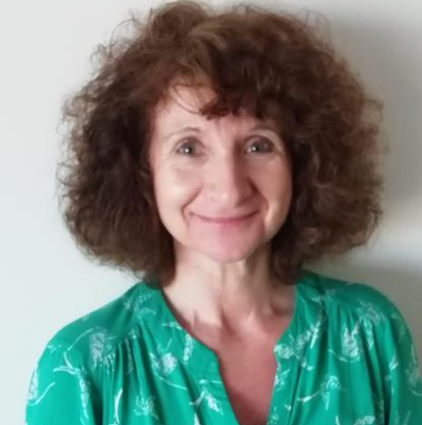
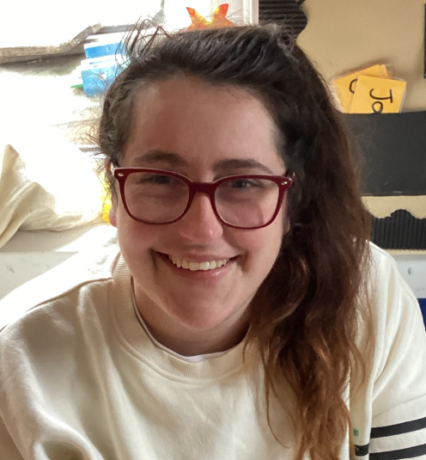
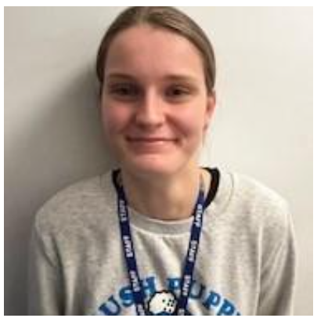
Staff at S&B
Mr Hardwick Headteacher | Mrs Taylor-Hicks Head of School | Mrs Wilson SENCO | Mrs Prestage Secretary
Miss Gallagher Class Teacher | Miss Evans Teaching Assistant | TBC Teaching Assistant
Squirrels – R/1
9 Reception
5 Year 1
14 Total

Slide 3





Our Curriculum

Slide 4

7 Areas of Learning
Prime Areas:
Communication and Language
Personal, Social, Emotional Development
Physical Development
Specific Areas:
Literacy
Mathematics
Understanding the World
Expressive Arts and Design

Slide 5
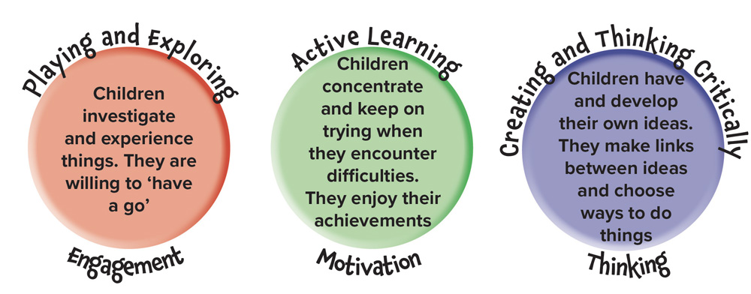
Characteristics of Effective Learning

Slide 6




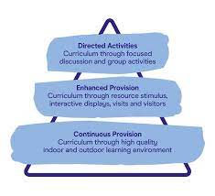
Learning Through Play

Slide 7
Example of our Timetable
8.30 – 8:45 | 8:45 – 10:15 | 10:15 – 10:40 | 10:40 – 11:00 | 11:00 – 11:40 | 11:40 – 12:00 | 12:10 – 13:15 | 13:15 – 13:40 | 13:40 – 15:15 | 15:20
Soft Start | CP + Snack | RWI | Worship | CP | Maths | Lunch and Playground | Topic | CP | Home
Continuous Provision (CP):
Child Initiated Learning with adult enhancements
Pupils will know it as provision or ‘go and play’
Topic:
Often story or book based
Topics change each term
Topic grids shared with parents

Slide 8





Read Write Inc - Phonics

Slide 9



Maths

Slide 10






PE
Day to be confirmed in September
Won’t start until full weeks (week 3)
There is an expectation they get changed (either into kit or uniform depending on the time of day)

Slide 11




Learning Outside
Wear Non-Uniform all day. Either Forest School or Nature Walks

Slide 12

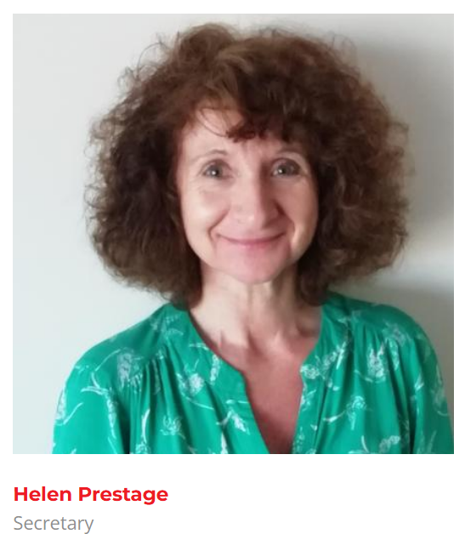



Communication with the Team

Slide 13
Breakfast Club
Everyday
£2.50 per day
From 8am

Slide 14
After School Club
Until 4pm - £5
Monday - Thursday
Until 5pm - £10
Including a light snack

Slide 15
Morning Drop Off
Classroom:
Classroom is open, parents can come inside, help your child to put their belongings away and choose an activity
Welcome to stay until 8:45am
Can drop at the gate if you prefer
Afternoon Collection
Classroom Door:
Pupils will not be allowed to leave the classroom until their name has been called
Please ensure your child is with you on the playground whilst waiting for siblings

Slide 16
September Transition
Week 0 - 3rd, 4th September
Home Visits (If you would like one – these are totally your choice)
Week 1 – Week Commencing 7th September
8.30am gates open & 8.45am parents to leave class
8.45am – 12.00pm Pupils in Class
12.00pm Home
Week 2 – Week Commencing 14th September
8.30am gates open
8.45am – 1.20pm Pupils in Class and Lunch
1.00pm Home
Week 3 – Week Commencing 21st September
Full time (8.30am – 3.20pm)
Gates open 8.30am. Parents to leave classroom by 8.45am

Slide 17



FOSBS
Friends of Sundridge and Brasted School
@FOSBS1860

Slide 18
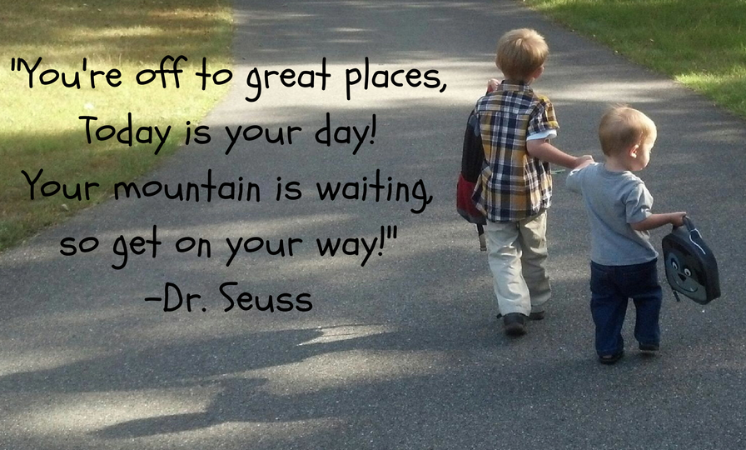

Any Questions?

