Slide 1
Welcome to Reception
Sundridge and Brasted Primary School

Slide 2
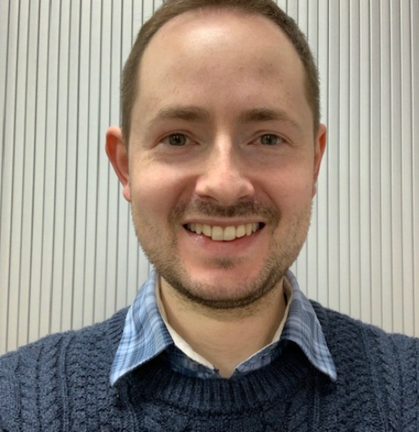
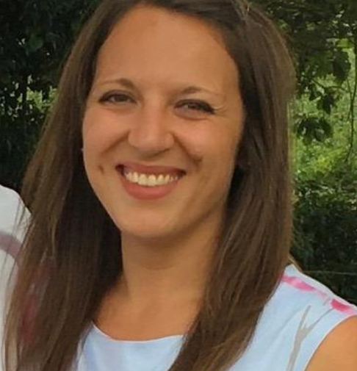
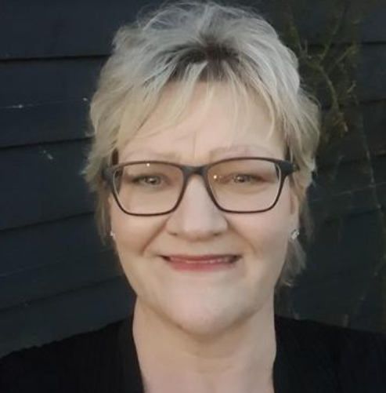
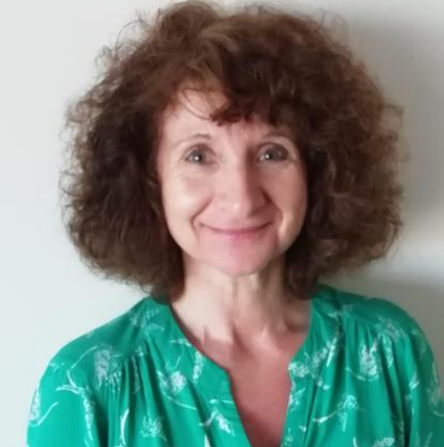
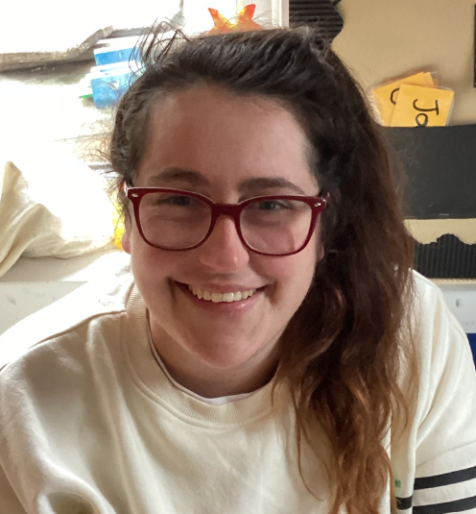
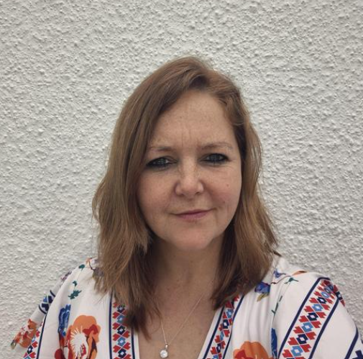
Staff at S&B
Mr Hardwick Headteacher | Mrs Taylor-Hicks Head of School | Mrs Wilson SENCO | Mrs Prestage Secretary
 | Miss Gallagher Class Teacher | Mrs Honour Teaching Assistant
16 Children in Class

Slide 3
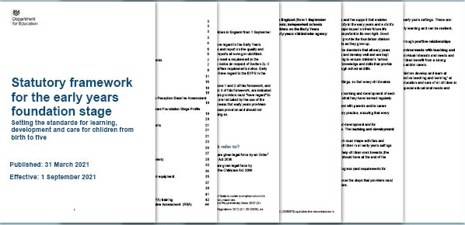
Our Curriculum

Slide 4

7 Areas of Learning
Prime Areas:
Communication and Language
Personal, Social, Emotional Development
Physical Development
Specific Areas:
Literacy
Mathematics
Understanding the World
Expressive Arts and Design

Slide 5
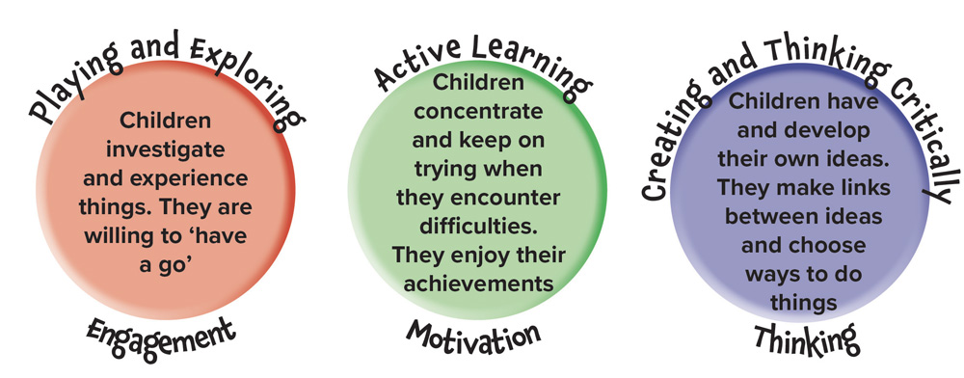
Characteristics of Effective Learning

Slide 6
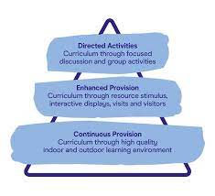



Learning Through Play

Slide 7
Example of our Timetable
8.30 – 9.00 | 9.00 – 9.30 | 9.30 - 11.45 | 11.45 – 12.00 | 12:00 – 1.15 | 1.15 – 1.30 | 1.30 – 2.45 | 2.45 – 3.00 | 3.00 – 3.15 | 320
Soft Start | RWI | CP + Snack | Maths | Lunch and Playtime | Topic | CP | Tidy Up | Worship | Home
Continuous Provision (CP):
Child Initiated Learning with adult enhancements
Pupils will know it as Discovery Challenge Time
Topic
Often story or book based
Topics change each term

Slide 8





Read Write Inc - Phonics

Slide 9




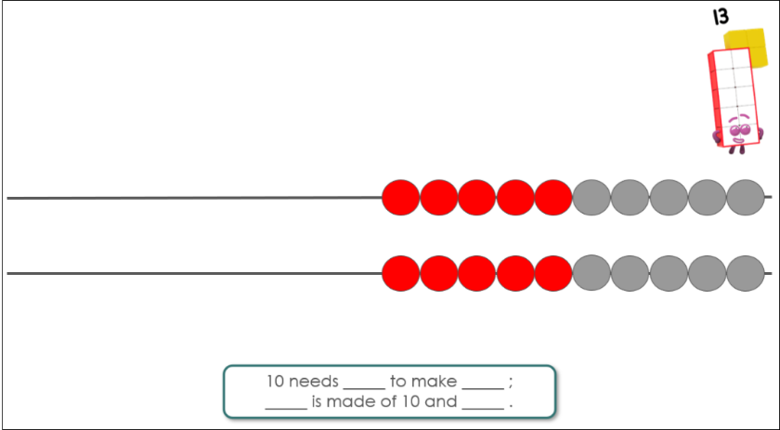
Mastering Number

Slide 10

PE
Thursday Morning
Wear PE Kit in the Morning
Bring School Uniform
Get changed after PE
Pupils will go home in School Uniform

Slide 11




Forest School
Wednesday
Afternoon
Wear Forest School Clothes all day

Slide 12
Morning Drop Off
Classroom:
Classroom is open, parents can come inside, help your child to put their belongings away and choose an activity
Welcome to stay until 8:50am
Can drop at the gate if you prefer
Afternoon Collection
Classroom Door:
Pupils will not be allowed to leave the classroom until their name has been called
Please ensure your child is with you on the playground whilst waiting for siblings

Slide 13
September Transition
Week 0 - 3rd, 4th, 5th September
Home Visits (If you would like one – these are totally your choice)
Week 1 – Week Commencing 8th September
8.30am gates open & 8.50am parents to leave class
8.50am – 12.00pm Pupils in Class
12.00pm Home
Week 2 – Week Commencing 15th September
8.00am gates open
8.00am – 1.00pm Pupils in Class and Lunch
1.00pm Home
Week 3 – Week Commencing 22nd September
Full time (8.00am – 3.20pm)
Gates open 8.30am. Parents to leave classroom by 8.00am

Slide 14



FOSBS
Friends of Sundridge and Brasted School
@FOSBS1860

Slide 15

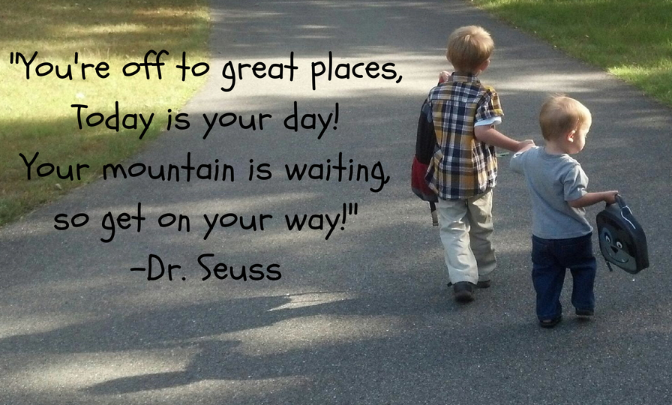
Any Questions?

