Slide 1
Welcome to Reception
Sundridge and Brasted Primary School

Slide 2
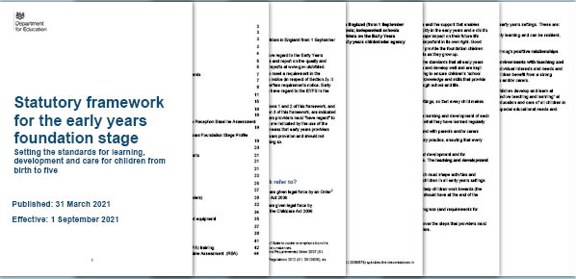
Our Curriculum

Slide 3

7 Areas of Learning
Prime Areas:
Communication and Language
Personal, Social, Emotional Development
Physical Development
Specific Areas:
Literacy
Mathematics
Understanding the World
Expressive Arts and Design

Slide 4
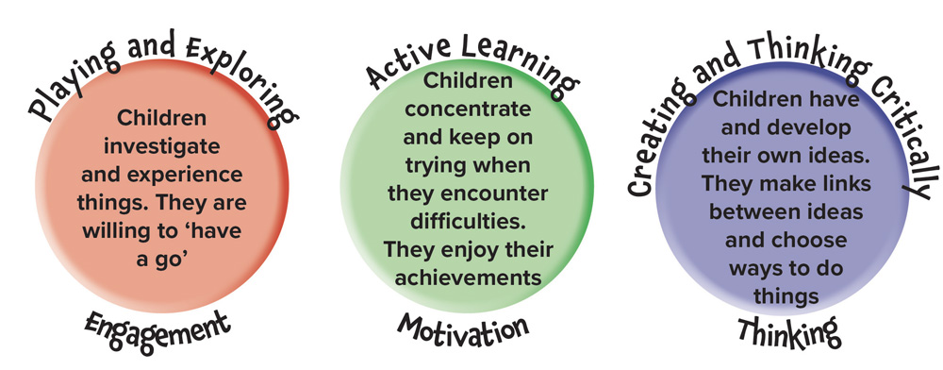
Characteristics of Effective Learning

Slide 5
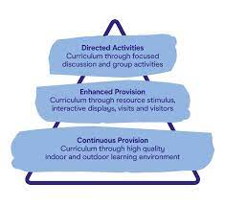



Learning Through Play

Slide 6
Adults in School
Headteacher – Mr Hardwick
Head of School – Mrs Taylor-Hicks
Office – Mrs P
SENCO – Mrs Wilson
Class Teacher – Miss Gallagher (Miss G)
We are appointing new adults to support in class.

Slide 7
Timetable
Continuous Provision (CP):
Child Initiated Learning with adult enhancements
Pupils will know it as Discovery Challenge Time
Monday - Thursday
8:30 – 9:00 | 9:00 – 9:30 | 9:30 – 11:45 | 11:45 – 12:00 | 12:00 – 1:15 | 1:15 – 1:35 | 1:35 – 2:45 | 2:45 – 3:00 | 3:00 – 3:20 | 3:20
Soft Start | RWI | CP + Snack | Write Dance | Lunch and Playtime | Maths | CP | Story | Worship | Home
Friday
8:30 – 9:00 | 9:00 – 9:30 | 9:30 – 11:00 | 11:00 – 12:00 | 12:00 – 1:15 | 1:15 – 1:35 | 1:35 – 2:45 | 2:45 – 3:00 | 3:00 – 3:20 | 3:20
Soft Start | RWI | CP + Snack | PE (including getting changed) | Lunch and Playtime | RE | CP | Story | Worship | Home

Slide 8






Uniform

Slide 9

PE
Friday Morning
Wear PE kit in the Morning
Bring School Uniform
Get changed after PE for the rest of the day
Starting Week 3 (full week of school)

Slide 10




Forest School
Wednesday Afternoon
Wear Forest School Clothes all day

Slide 11





Read Write Inc - Phonics

Slide 12


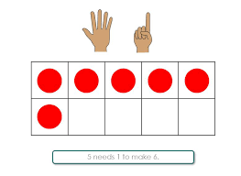
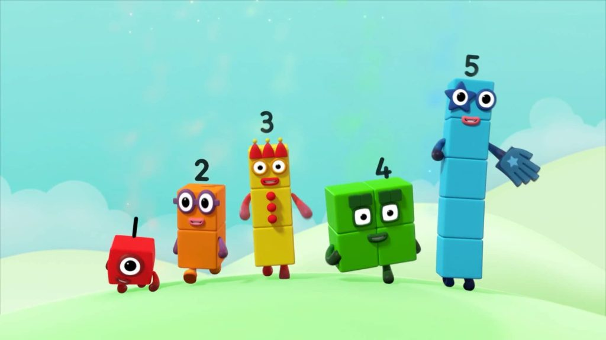
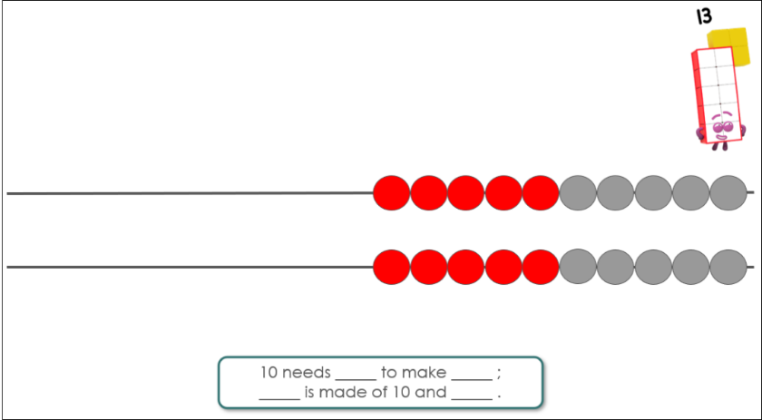
Mastering Number

Slide 13
Morning Drop Off
Classroom:
Classroom is open, parents can come inside, help your child to put their belongings away and choose an activity
Welcome to stay until 8:50am
Can drop at the gate if you prefer
Afternoon Collection
Classroom Door:
Pupils will not be allowed to leave the classroom until their name has been called
Please ensure your child is with you on the playground whilst waiting for siblings

Slide 14
September Transition
Week 1:
8:30 gates open
8:50 parents to leave class
9:00 – 12:00 Pupils in Class
12:00 Home
Week 2:
8:30 gates open
8:50 parents to leave class
9:00 – 13:00 Pupils in Class and Lunch
13:10 Home
Week 3:
Full time (8:50am – 3:20pm)
Gates open 8:30am. Parents to leave classroom by 8:50am

Slide 15


Any Questions?

